Slide 1
Easify
Team - 3
Neeraj Kulkarni
Janvi Ramani
Anvai Patil
Dhruvil Shah
Varun Patel
Guided By
Professor Henry Wong

Slide 2





Agenda
Introduction
Team members
Problem Statement
Project Description
Personas
Technologies and Design
Front-end
Back-end
Cloud
Architecture
Activity Diagram
Sprint 6 recap & Sprint 7
Sprint Backlog
Test Cases
Burndown Chart
Velocity Chart
Completed Committed Ratio
Sprint 7 Results
Retrospective
Future work
Sprint 8 - Sprint Backlog

Slide 3
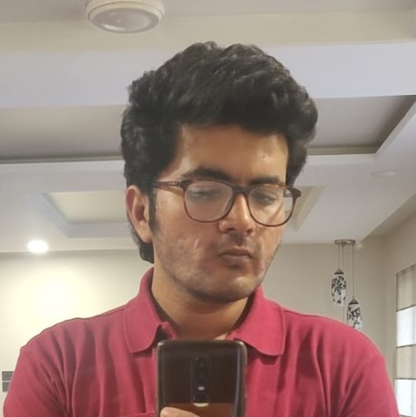



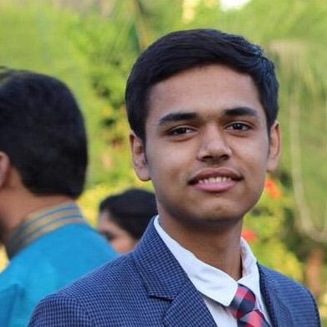
Neeraj Kulkarni Backend Developer
Janvi Ramani
Backend Developer
Anvai Patil
Frontend Developer
Dhruvil Shah
Cloud Engineer
Varun Patel
Full Stack Developer

Slide 4
Problem Statement
Using current scrum application , we can see that there can be end date failure in which people fail to finish the project. There can be situation such that people can be cooperative or committed.
Sometimes daily meetings can frustrate team members and they do not like to perform daily meetings.
Using the remote or onsite project, there can be situation such that one person transfer to another company in middle of project. In this situation, it is difficult to complete project and group will have negative impact.

Slide 5
Project Description
Easify Overview
We are designing an application called Easify. Easify is an application that helps you manage scrum-based projects easily and effectively.
To manage the project, Easify will provide Product Backlog management and Sprint Backlog management features. In addition, users can use Easify’s Share Images and Chat features to share each other work and thoughts.
The Calendar feature is there so that users can plan their work. Users can use the Activity Map feature to understand the project workflow and estimate the users’ workflow.

Slide 6
Personas

Slide 7

Persona - 1:
Name: John
Age: 45
Post: Product Owner
Currently, John is working from home as the owner of the product developed by the team. He is 45 years old and he has a family. It is his duty to ask the scrum master about the progress of the product. It is his responsibility to maintain the system and to determine if the product design will be completed on time. Easify gives him the ability to see the progress and track the work of his team. He can offer suggestions right away through this tool.

Slide 8

Persona-2:
Name: David
Age: 35
Post: Scrum Master
David manages a team of five people. The team isn't located in one city, so offline meetings are impossible. With Easify, he can view the progress of tasks and see the daily or weekly report. Additionally, he can prioritize the task so it can be worked on by the development team.

Slide 9

Persona-3
Name: Olivia
Age: 29
Post: Developer
Olivia is part of a team. She needs to develop a system and report daily to the scrum master. She wants to maintain unity and support within the team. Team members can ask for help from one another. Using Easify, users can share the resources instantly and they don't even have to wait. The app lets them chat and share all the work and discuss their problems. Through this app , they can test and can provide the feedback to programmer.

Slide 10


Slide 11



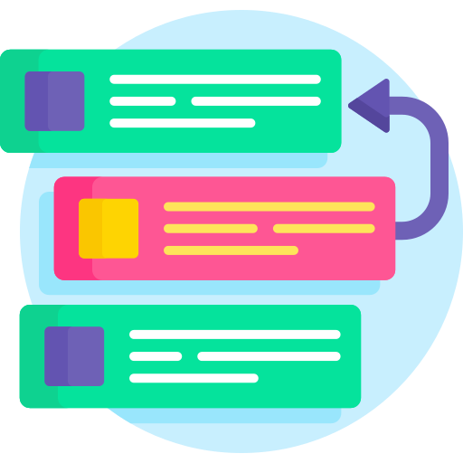
MVP
Authentication
Register - Login - Logout
Users can Register in the system by entering name, email and password. They can login into the system by entering correct email and password. Users can Log out from the system.
Project
Creation - Settings
Users can create projects by giving unique name and selecting project profile photo. Users can share the projects with other members.
Product Backlog
Users can add items to their product backlog. They can modify the item’s type, priority and sprint. Users can also delete the backlog item from the product backlog.
Sprint - Sprint Backlog
Users can create sprint by giving name and duration. They can add items from product backlog to sprint backlog. Users can also delete the sprint backlog item or also can delete the sprint.

Slide 12

Technologies and Design

Slide 13


Technologies - Front-end
React JS is a front-end JavaScript library for building user interfaces based on UI components. React allows us to create reusable UI components.
HTML, CSS and JavaScript work together to form the front-end design of a website by applying information that affects content, style and interactivity of a site.

Slide 14



Technologies - Back-end
Laravel is a back-end PHP-based framework. It's an entirely server-side framework that manages data with the help of Model-View-Controller (MVC) design.
PHP is known as a general-purpose scripting language. It was among the first server-side languages.
SQLite DB Browser is a high quality, visual tool to create, design, and edit database files compatible with SQLite.

Slide 15


Technologies - Cloud
Amazon Simple Storage Service (Amazon S3) is a service offered by Amazon Web Services (AWS) that provides object storage through a web service interface. It offers scalability, data availability, security, and performance.

Slide 16
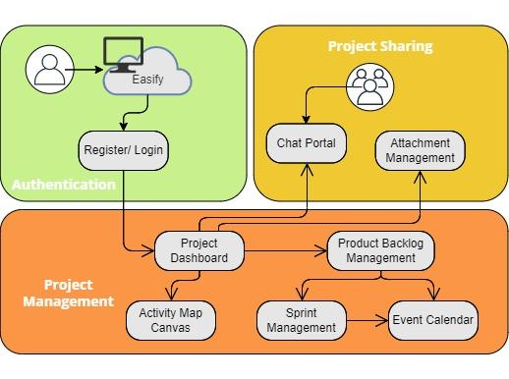
Architecture

Slide 17
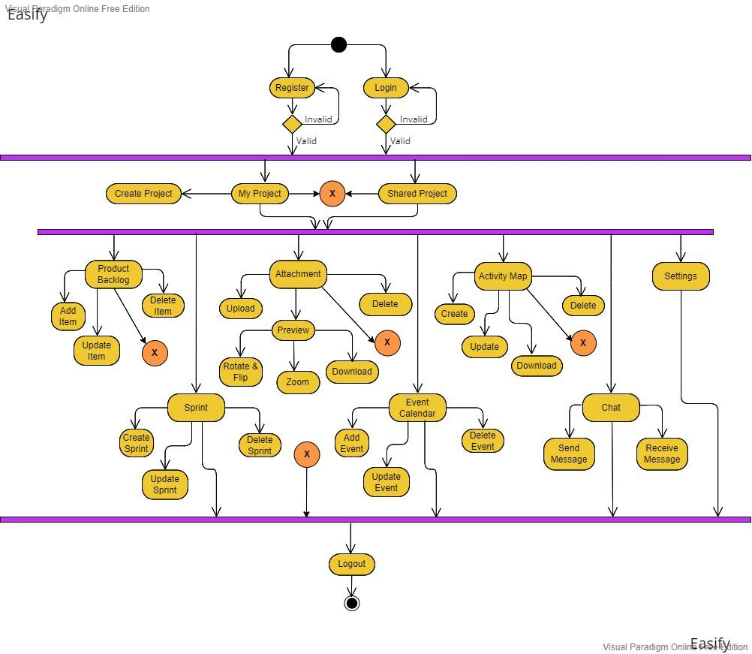
Activity Diagram

Slide 18

Sprint 6 Recap
Sprint Backlogs

Slide 19
Sprint - 6: User Stories
Total 22 Story Points
User Story: As a developer or creator, I want to be able to upload the images so that I can save my outcome or a problem
Acceptance Criteria: Given developer or creator is on attachment screen, when user click on upload image and try to upload image from personal device, then system should accept image files
EAS-70
Points - 3
User Story: As a developer or creator, I want to be able to see the images uploaded by me or other members so that I can see which photos are uploaded
Acceptance Criteria: Given developer or creator is on attachment screen, then system should display the files uploaded by all project members
EAS-71
Points - 2
User Story: As a developer or creator, I want to be able to perform some operations (like fullscreen preview, rotate, zoom in-out, flip, download) on the images so that I can perform these operations within the system itself
Acceptance Criteria:
• Given developer or creator is on attachment screen, when user click on the full screen mode, then system should display the image full screen
• Given developer or creator is on attachment screen, when user click on the rotate or flip mode, then system should rotate or flip the image accordingly
• Given developer or creator is on attachment screen, when user click on the zoom in & out mode, then system should zoom the image accordingly
• Given developer or creator is on attachment screen, when user click on the download button, then system should download the image.
EAS-72
Points - 5
User Story: As a developer or creator, I want to be able to delete the uploaded images so that I can remove unnecessary/ wrong photos
Acceptance Criteria: Given developer or creator is on attachment screen, when user click on the delete image, then system should delete the image from the database
EAS-73
Points - 2

Slide 20
Sprint - 6: User Stories Continue
Total 22 Story Points
User Story: As a product owner or scrum master or creator, I want to be able to create user activity map for the project so that I can understand the user activities better
Acceptance Criteria:
• Given product owner or scrum master or creator is on activity map screen, when user click on create node for the activity map, then system should create the node
• Given product owner or scrum master or creator is on activity map screen, when user connects the nodes for the activity map, then system should connects the node
EAS-74
Points - 5
EAS-76
Points - 2
User Story: As a product owner or scrum master or creator, I want to be able to download user activity map so that I can share it with other people
Acceptance Criteria: Given product owner or scrum master or creator is on activity map screen, when user click on download activity map, then system should download the activity map
User Story: As a product owner or scrum master or creator, I want to be able to edit/ delete user activity map so that I can modify the user activities
Acceptance Criteria:
• Given product owner or scrum master or creator is on activity map screen, when user edit the node or edge, then system should modify the node or edges details in database
• Given product owner or scrum master or creator is on activity map screen, when user delete the node or edge, then system should delete the node and connected edges from the database
EAS-75
Points - 3

Slide 21
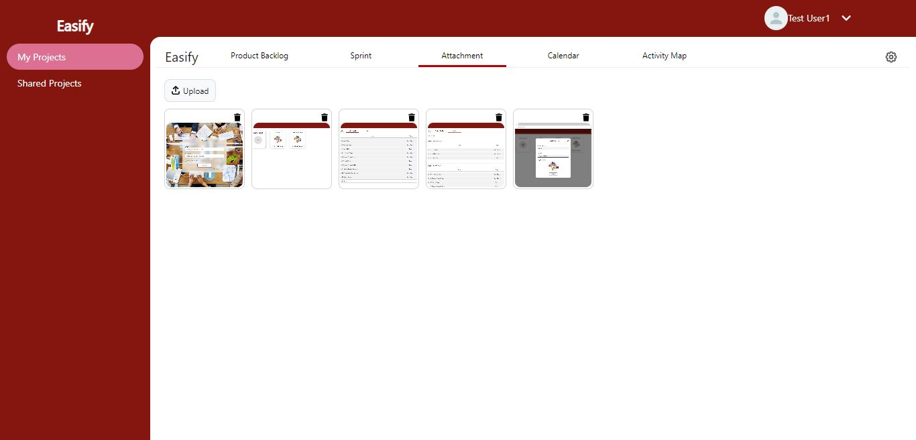
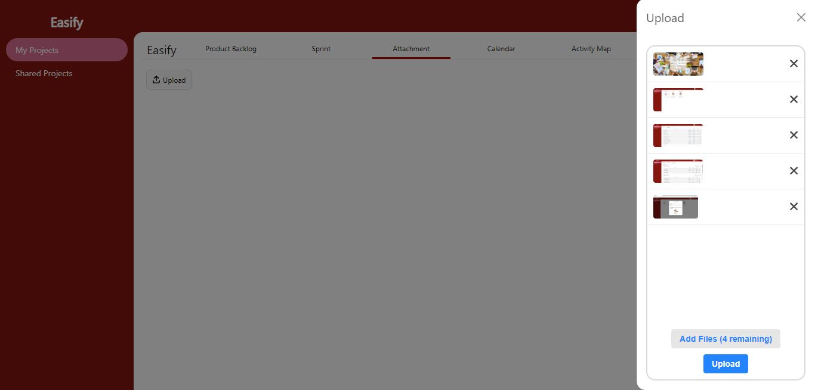
Sprint - 6: Results
Attachment Page
Users can see the uploaded photos by projects members. Also can delete the photo.
Attachment Page - Upload Dropzone
Users can drop or browse the photos in the right side dropzone. Max file limit is 9 files. Users can also cancel the uploading of each photo.

Slide 22
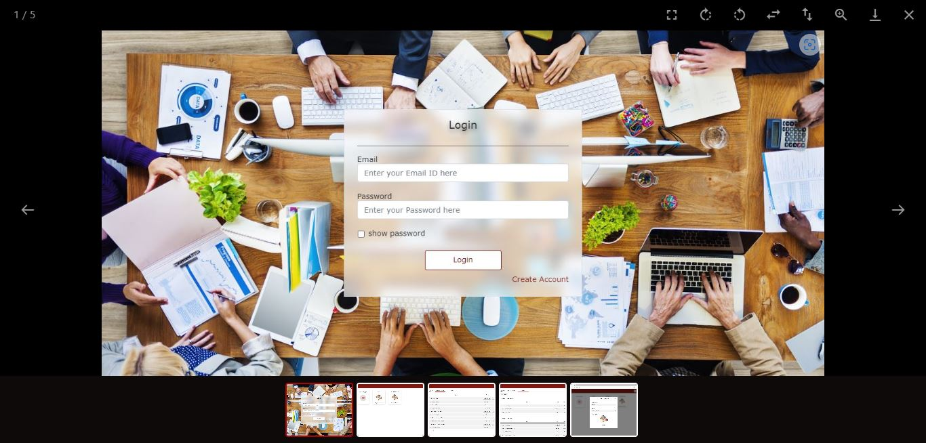
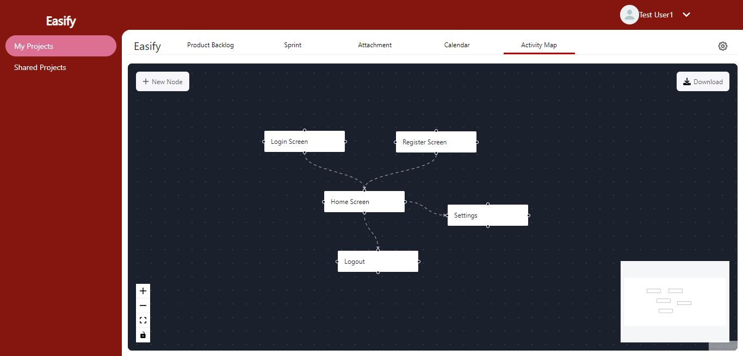
Sprint - 6: Results Continue
Attachment Page - Photo Preview
Users can preview the photos and also can rotate, flip horizontally-vertically, zoom in & out and download the photo.
Activity Map Page
Users can create activity maps for their projects. They can also zoom in & out and download the activity map.

Slide 23
Sprint 6
Sprint 7
Completed feature: Attachment, Activity Map
Attachment feature:
Easify users can upload the photos to Easify and can preview them
Other project members can see the photos and also download it
Activity Map feature:
Easify users can create activity maps for their projects and can also download them
Completed feature: Chat
New design
We developed the frontend and backend for the Chat feature
Easify will create a chat group while creating the project
Easify users can chat with project members
Each project has its own chat screen
Easify users can now open any feature by going to feature’s unique url

Slide 24
Improvement from the Professor’s Feedback
1) Change the Architecture diagram. Example is given by the professor
2) Write Product backlog in table format with user story id
3) Put Sprint backlog slide above the Committed and Completed User Stories
4) In sprint backlog, do not show subtasks
5) For future sprint, show the sprint backlog

Slide 25
Product Backlog
ID | Feature | Item | Priority | Sprint | Status
EAS-87 | Chat | As a product owner or scrum master or developer or creator, I want to be able to see the chat group for the projects so that I can chat with others about the project | Mid | Sprint 7 | Done
EAS-88 | Chat | As a product owner or scrum master or developer or creator, I want to be able to send messages in project group so that I can notify others about tasks or bugs | Mid | Sprint 7 | Done
EAS-89 | Chat | As a product owner or scrum master or developer or creator, I want to be able to receive the messages from project group so that we can interact with each other and keep track of the work | Mid | Sprint 7 | Done
EAS-90 | Chat | As a product owner or scrum master or developer or creator, I want to be able to see the previous messages of project chat group so that I can see the previously discussed things on the project chat group | Mid | Sprint 7 | Done
EAS-2 | Register | As a new user, I want to be able to receive authentication email so that the system can authenticate me | Mid | Sprint 8 | To Do
EAS-4 | Login | As a registered user, I want to be able to request for change the password if I forgot it so that I don't lose my account and data | Mid | Sprint 8 | To Do
EAS-6 | Profile Settings | As a user, I want to be able to edit my details such as name and profile photo so that I can edit my profile | Low | Sprint 8 | To Do
EAS-7 | Profile Settings | As a user, I want to be able to change my password so that I can keep my account secure | Low | Sprint 8 | To Do
EAS-13 | Project Settings | As a creator of the project, I want to be able to change the project profile photo, so that I can update project photo | Mid | Sprint 8 | To Do

Slide 26

Sprint 7

Slide 27
Sprint - 7: Sprint Backlog
ID | Item | Priority | Story Points | Status
EAS-87 | As a product owner or scrum master or developer or creator, I want to be able to see the chat group for the projects so that I can chat with others about the project | Mid | 3 | Done
EAS-88 | As a product owner or scrum master or developer or creator, I want to be able to send messages in project group so that I can notify others about tasks or bugs | Mid | 8 | Done
EAS-89 | As a product owner or scrum master or developer or creator, I want to be able to receive the messages from project group so that we can interact with each other and keep track of the work | Mid | 8 | Done
EAS-90 | As a product owner or scrum master or developer or creator, I want to be able to see the previous messages of project chat group so that I can see the previously discussed things on the project chat group | Mid | 2 | Done
EAS-91 | Redesign the UI | Mid | NA | Done
EAS-92 | Research about different chat libraries supporting ReactJs | High | NA | Done
EAS-93 | Integrate Chat Screen with Project screens and Backend APIs | High | NA | Done
EAS-94 | Testing for Sprint - 7 | Mid | NA | Done
EAS-95 | Create presentation for Deliverable - 7 | Low | NA | Done
EAS-96 | Create presentation video and demo video for Deliverable - 7 | Mid | NA | Done
EAS-97 | Update Tech Paper | Low | NA | Done
EAS-98 | Update Github Wiki page | Low | NA | Done

Slide 28
Sprint - 7: Committed and Completed User Stories
Total 21 Story Points
100% Completed
User Story: As a product owner or scrum master or developer or creator, I want to be able to see the chat group for the projects so that I can chat with others about the project
Acceptance Criteria: Given product owner or scrum master or developer or creator is on Chat screen, then system should display the project group
EAS-87
Points - 3
User Story: As a product owner or scrum master or developer or creator, I want to be able to send messages in project group so that I can notify others about tasks or bugs
Acceptance Criteria: Given product owner or scrum master or developer or creator is on Chat screen, when user type any message and click on send, then system should send the messages to project group
EAS-88
Points - 8
User Story: As a product owner or scrum master or developer or creator, I want to be able to receive the messages from project group so that we can interact with each other and keep track of the work
Acceptance Criteria: Given product owner or scrum master or developer or creator is on Chat screen, when other user send any message, then system should display the new message to the current logged-in user
User Story: As a product owner or scrum master or developer or creator, I want to be able to see the previous messages of project chat group so that I can see the previously discussed things on the project chat group
Acceptance Criteria: Given product owner or scrum master or developer or creator is on Chat screen, when user open the chat screen, then system should display all the messages which are send by the user or others
EAS-89
Points - 8
EAS-90
Points - 2

Slide 29
Sprint - 7: Test Cases
ID | User Story ID | Feature | Test Case | Expected Output | Actual Outcome | Status
EAST-42 | EAS-87 | Chat | User wants to see the project chat group | User should be able to see the project chat group | User is able to see the project chat group | Pass
EAST-43 | EAS-88 | Chat | User wants to send the message in chat group | User should be able to send the message in chat group | User is able to send the message in chat group | Pass
EAST-44 | EAS-89 | Chat | User wants to receive the message from other members | User should be able to receive the message from other members | User is able to receive the message from other members | Pass
EAST-45 | EAS-90 | Chat | User wants to see the previous discussions of chat group | User should be able to see the previous discussions of chat group | User is able to see the previous discussions of chat group | Pass
EAST-46 | EAS-91 | New Design | User wants to open and close the side panel based on the screen size | User should be able to open and close the side panel | User is able to open and close the side panel | Pass
EAST-47 | EAS-91 | New Design | User wants to open the projects subpages by unique URL | User should be able to open the projects subpages by unique URL | User is able to open the projects subpages by unique URL | Pass

Slide 30
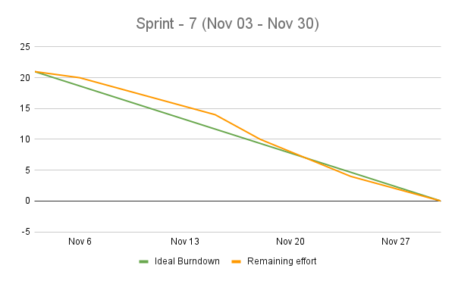
Sprint - 7: Burndown Chart

Slide 31
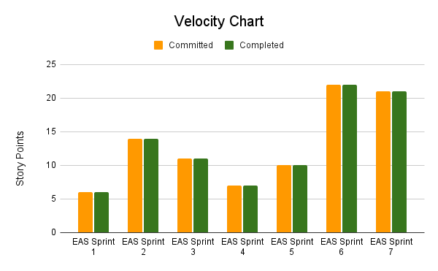
Velocity
Average Velocity
= (6+14+11+7+10+22+21)/7
= 13.00

Slide 32
Completed Committed Ratio
Sprint | Committed | Completed | Ratio
EAS Sprint 1 | 6 | 6 | 100.00%
EAS Sprint 2 | 14 | 14 | 100.00%
EAS Sprint 3 | 11 | 11 | 100.00%
EAS Sprint 4 | 7 | 7 | 100.00%
EAS Sprint 5 | 10 | 10 | 100.00%
EAS Sprint 6 | 22 | 22 | 100.00%
EAS Sprint 7 | 21 | 21 | 100.00%
Average Completed Committed Ratio = 100.00%
Current Completed Committed Ratio (Sprint 7) = 100.00%

Slide 33
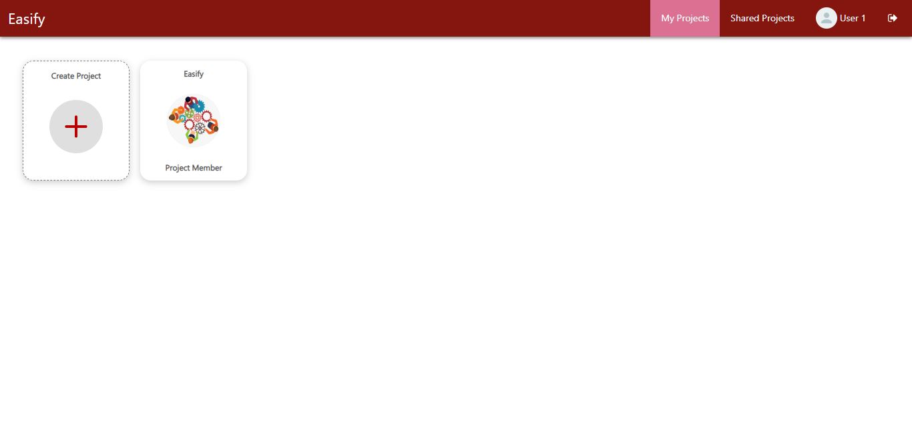
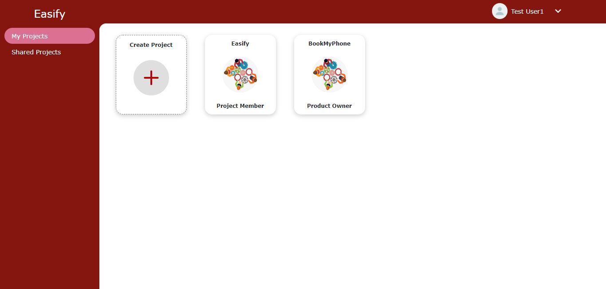
Sprint - 7: Results
New Design My Project/ Shared Project Page
Now users can access the “My Project” and ”Shared Project” from the header. Side Panel is removed from the new design.
Old Design My Project/ Shared Project Page
In old design, we have side panel for the My Project and Shared Project Page.

Slide 34
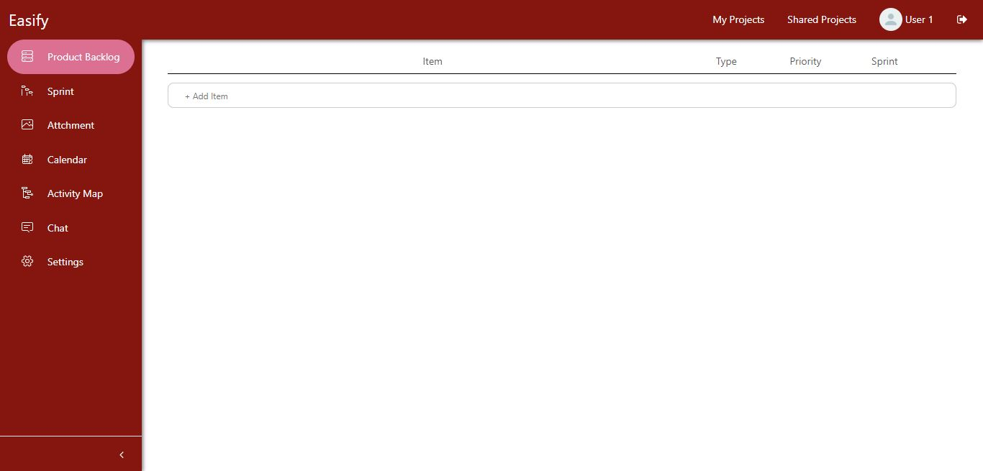
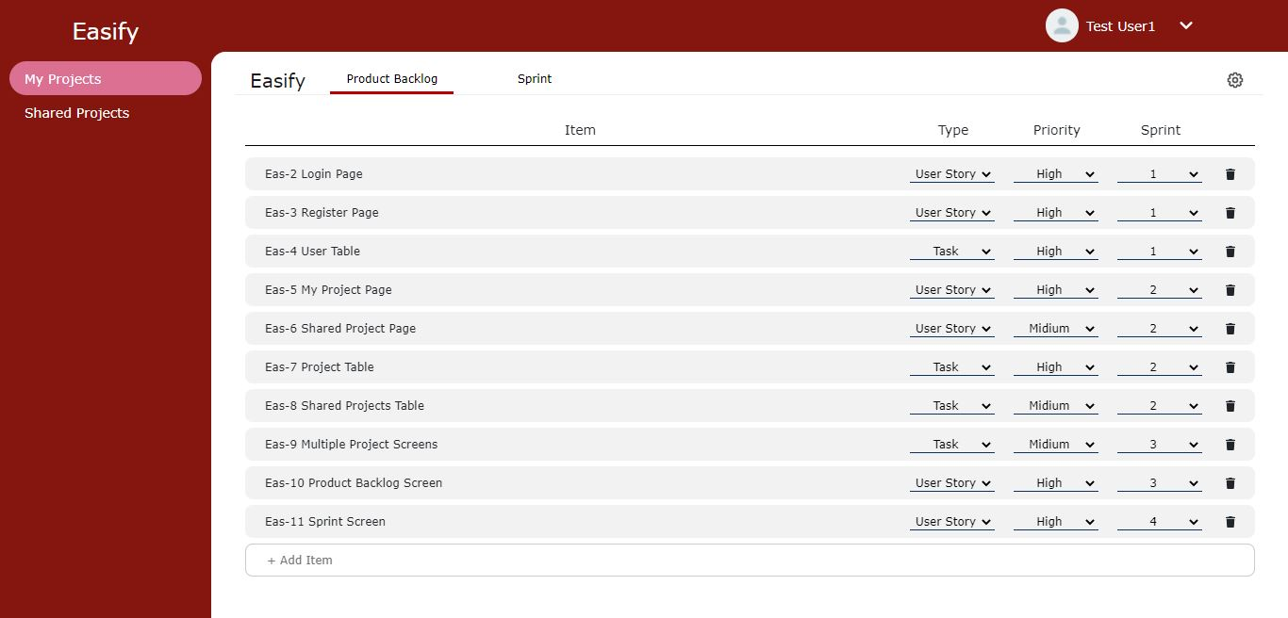
Sprint - 7: Results Continue
New Design of Project Subpages
Now users can access all the subpages from the side panel.
Old Design of Project Subpages
In old design, we have tabs for each subpages. We have removed those.

Slide 35
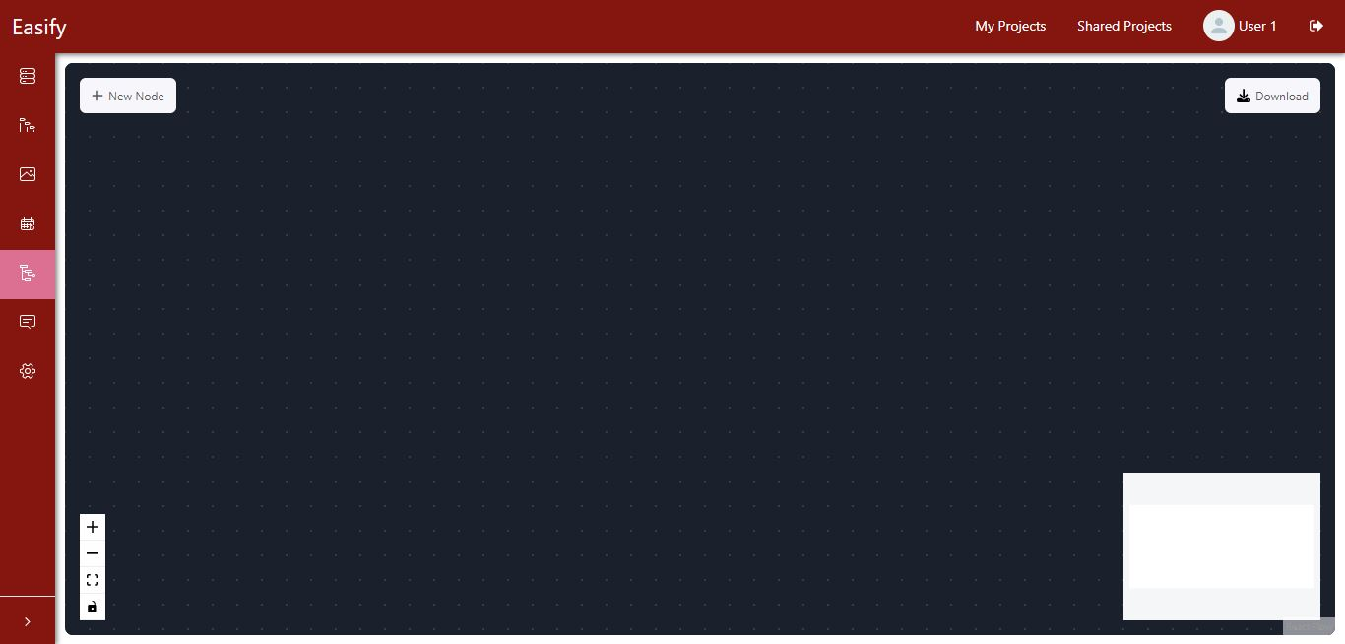
Sprint - 7: Results Continue
New design of Side Panel
In new design, the side panel is collapsible. So that users can open and close the panel based on their screen size and preferences.
Old design of Side Panel
In old design, side panel was static, not collapsible.

Slide 36
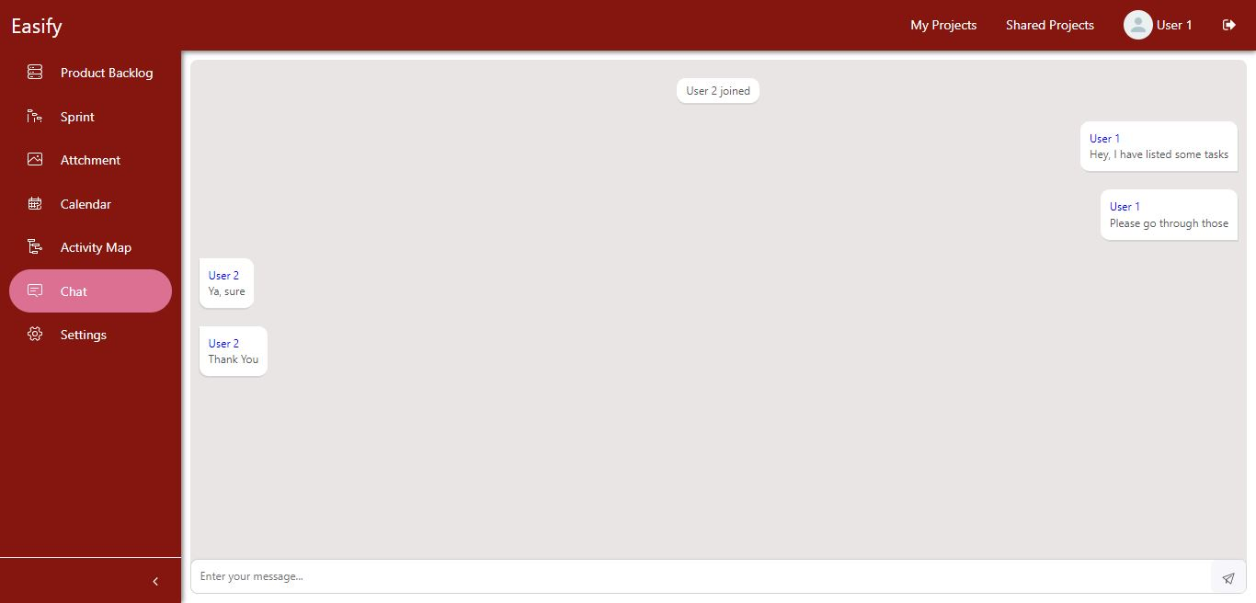
Sprint - 7: Results Continue
Project Chat Page
Users can chat with shared members. Each project has its own chat screen.

Slide 37
Retrospective
What went well
Speeding up the research to keep up according to the schedule
Successfully implemented the professor’s feedback
What can be improved
Team has to improve the knowledge on technologies and frameworks
All should know the deadlines and schedule
Action items
Focus on the deliverable deadlines

Slide 38
Sprint - 8
ID | Item | Priority | Status
EAS-2 | As a new user, I want to be able to receive authentication email so that the system can authenticate me | Mid | To Do
EAS-4 | As a registered user, I want to be able to request for change the password if I forgot it so that I don't lose my account and data | Mid | To Do
EAS-6 | As a user, I want to be able to edit my details such as name and profile photo so that I can edit my profile | Low | To Do
EAS-7 | As a user, I want to be able to change my password so that I can keep my account secure | Low | To Do
EAS-13 | As a creator of the project, I want to be able to change the project profile photo, so that I can update project photo | Mid | To Do
EAS-99 | Integrate Authentication page with Register and Login screen and backend APIs | Mid | To Do
EAS-100 | Integrate Profile Settings with main UI | Mid | To Do
EAS-101 | Integrate Project Settings with project screens and backend APIs | Mid | To Do
EAS-102 | Redesign the UI and redirections | Low | To Do

Slide 39

Group Wiki
https://github.com/DV192/Stonecrusher/wiki

Slide 40
Thank You

